Slide 1
Identifying Errors in a Standardized HTS Register
Continuous Quality Improvement (CQI) for Documentation

Slide 2
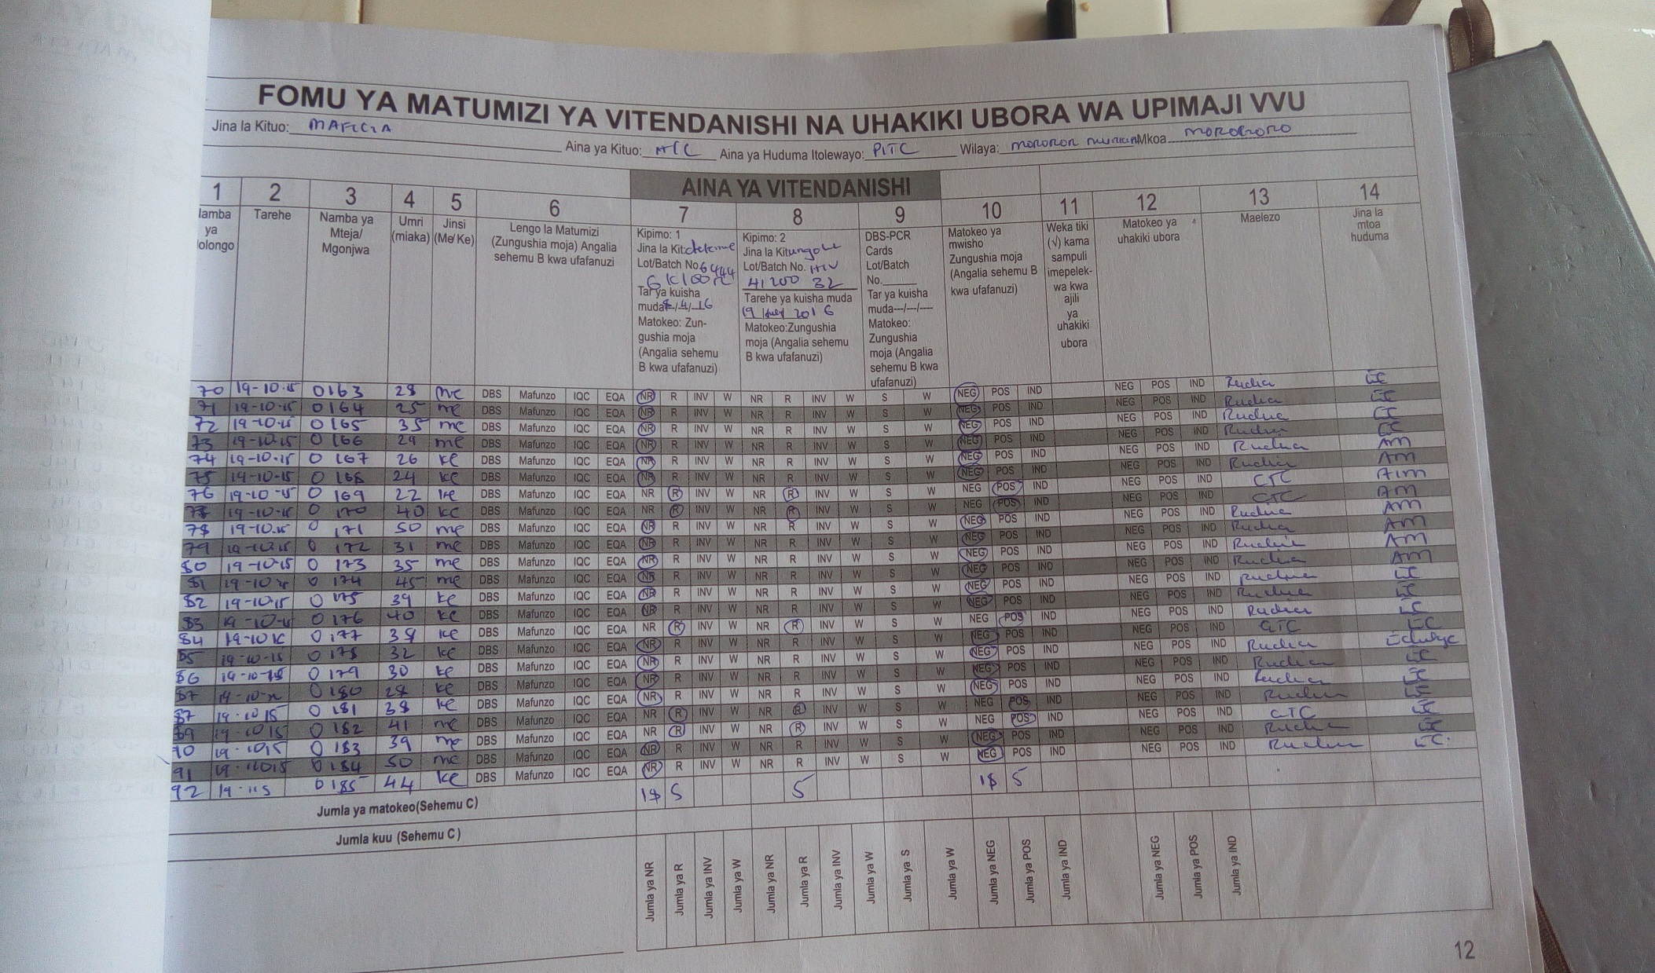
1

Slide 3
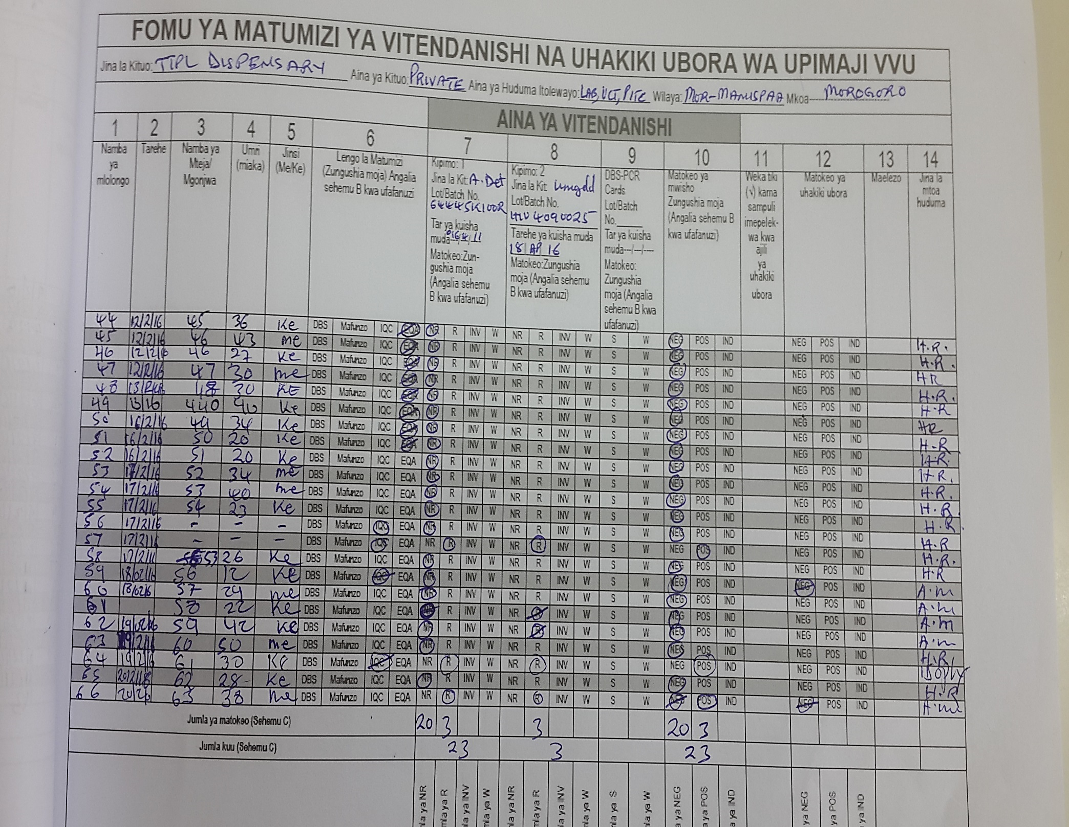
2

Slide 4
2

Slide 5
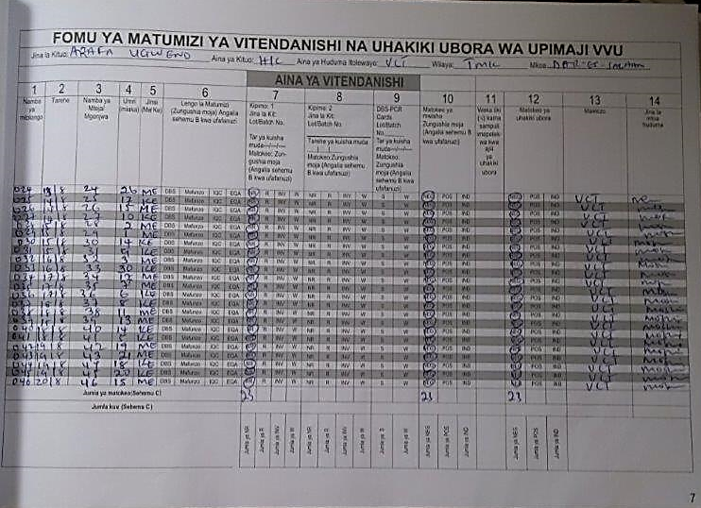
3

Slide 6
3

Slide 7
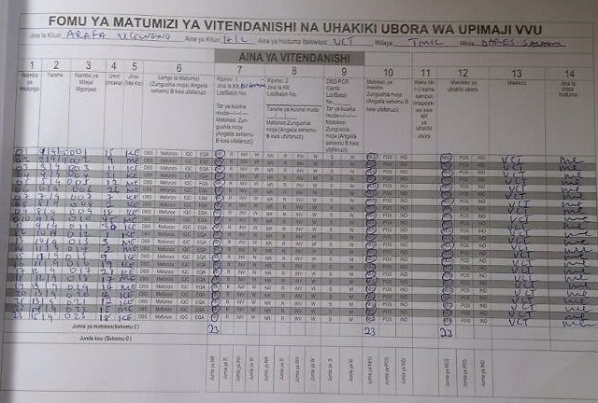
4

Slide 8
4

Slide 9
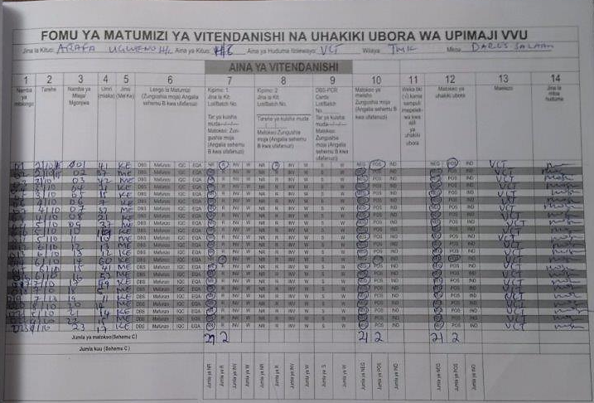
5

Slide 10
5

Slide 11
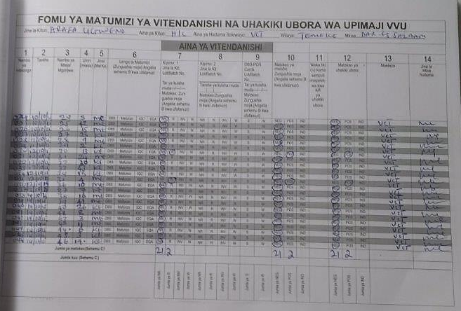
6

Slide 12
6

Slide 13
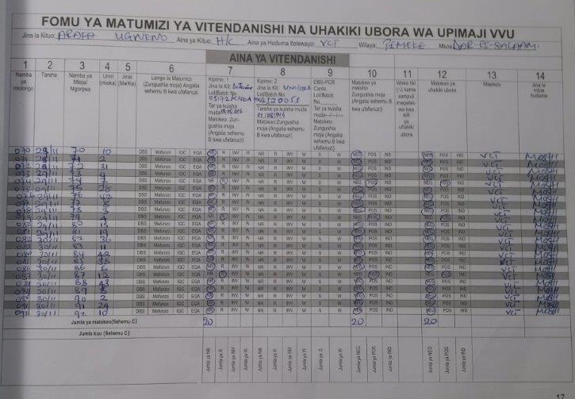
7

Slide 14
7

Slide 15
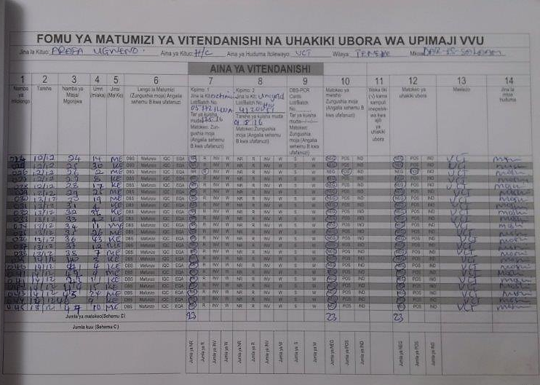
8

Slide 16
8

Slide 17
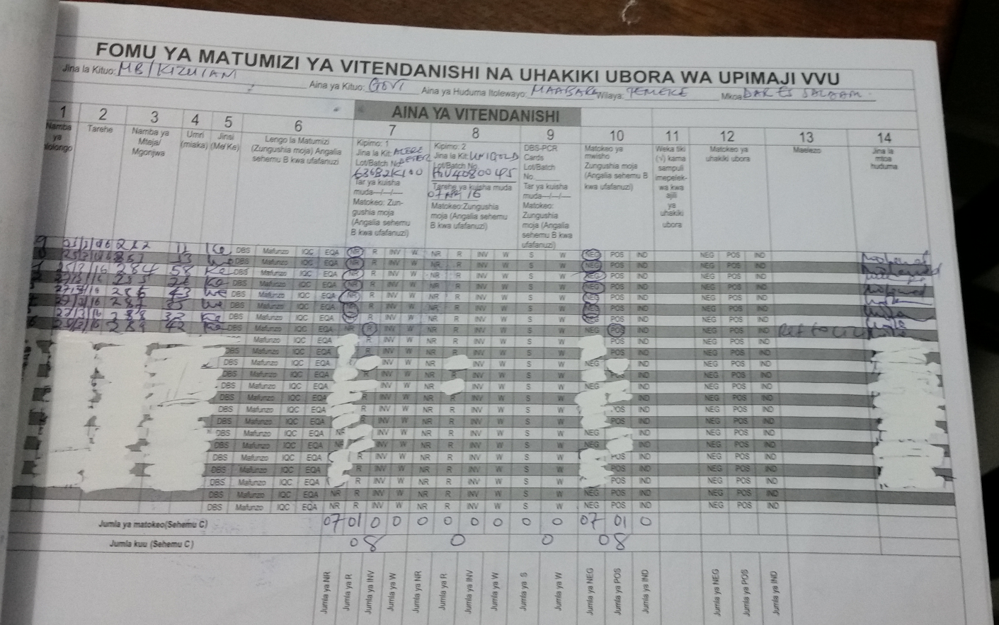
9

Slide 18
9

